Slide 1
Statistics In FRC (Theoretical)
Caleb Sykes
Presented at TRI, June 2019

Slide 2
Who am I?
Caleb Sykes
Student, FRC 2052 (2009-2013)
Mentor, FRC 4536 (2013-2017)
Has played around a lot with FRC statistics (2016ish to present)
B.S. in Electrical Engineering from the University of Minnesota
M.S. in Electrical Engineering from the University of Minnesota
Currently unemployed (June 2019), if you have a job opening let me know ☺

Slide 3
Definitions
OPR: Offensive Power Rating, I use it interchangeably with calculated contribution because I hate the name OPR
Half-match: All of the match data for one alliance in one match
Elo: When I talk about Elo, I’m referring specifically to the Elo model I have developed and published. Calculated contributions have been around long enough to have become standardized, but since Elo is still very new to FRC, there exist alternate models.

Slide 4
Why do we want metrics?
You should check out my other presentation for a better answer
Broadly, there is insight you can get from metrics like calculated contributions or Elo that you can’t obtain as easily using conventional scouting methods.
Also they’re fun

Slide 5
Assumptions for calculated contributions
Choose to represent each team’s strength with a single continuous metric
The metric we choose is their arithmetic mean (average) contribution to the match score
We choose to combine individual contributions into an alliance combination linearly and equally weighted for all teams
Besides alliance composition, we are only allowed to look at one data point (score in the case of OPR) per half-match
All data must come from a finite set of quals matches within the current season
At least as many half-matches as teams in the dataset
Surrogates and DQed teams are treated no differently from other teams

Slide 6
Ways to calculate OPR
OPR at it’s root is just linear regression, which is a common statistical tool with many calculation methods. Here are 3, ordered from least computationally efficient to most:
Iterative Averages: Find each team’s “average” score, and make a score estimate based on that. Then for each team’s match, subtract out the partner’s strength and find a better “average” score that accounts for your partners
Linear Algebra (Matrix Inversion): Use tools of linear algebra to do the above iterative methods in a closed-form way
Linear Algebra (Choleskey decomposition): Since matrix inversion is computationally intensive, this is an even faster way to perform OPR calculations

Slide 7
OpR calculation method 1, iterative averages
The idea of this method is just to find each team’s average score, but then to incorporate information about partners to improve on this average. Repeating this step repeatedly will get us something very close to OPR
We’ll be working through your worksheets for this method, so I recommend pulling out a calculator app and getting together in groups of 2-5
I have created the simplest non-trivial example I could on this worksheet, which includes only 5 teams, 4 full matches, and 2 teams per half-match. All concepts here will translate to other OPR calculations, with 3 teams per half match and far more matches and teams.

Slide 8
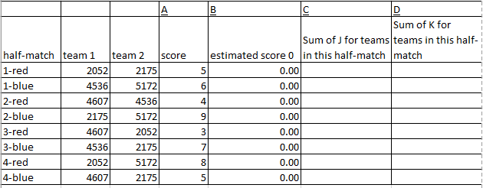
OpR calculation method 1, iterative averages
The very first step that we’re going to do is to come up with an initial guess for the scores. On your sheets, I have made the first guess 0, and in Col I, you’ll also see starting OPR estimates of 0.
Next, I want you to simply find the error of our estimate to the actual score, and divide this by 2 (because any error will be equally split between 2 teams). Place this result in Col E.

Slide 9
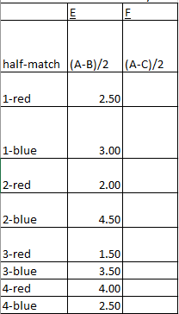
OpR calculation method 1, iterative averages
This value represents how good or bad our predictions are for each match. Obviously, we would like all of these values to be as close to 0 as possible.
Now, in Column G, I want you to take the average from column E for the matches each team participates in

Slide 10
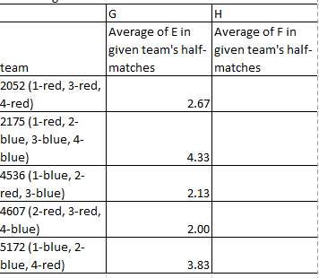
OpR calculation method 1, iterative averages
This value here is basically each team’s average score, it’s a little bit different, because we are only taking half of the final score, but it’s the same idea as a simple average
Now, take the results from G, and add them to I (this is super easy right now)

Slide 11
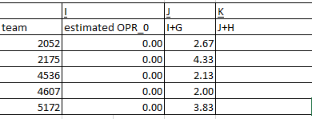
OpR calculation method 1, iterative averages
So now we have our first iteration of estimated OPRs! That wasn’t too bad right?
Don’t worry, things will get a bit harder the second time around
Now, I want you to take the results from J, and bring them up to the top to “estimate” the match score

Slide 12
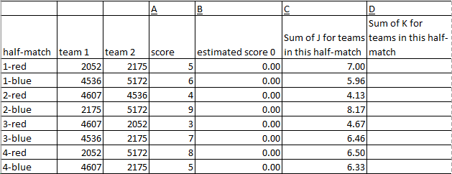
OpR calculation method 1, iterative averages
Not too bad, right? These estimated scores line up reasonably well (+-2 points) with the actual scores.
Now just repeat all of the steps

Slide 13

Pause for questions

Slide 14
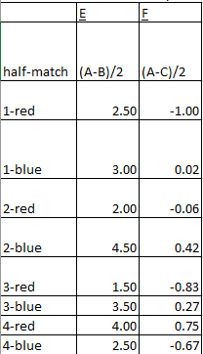
OpR calculation method 1, iterative averages
Notice how much smaller the “errors” are the second time around, that’s good, that means we are getting better estimates

Slide 15
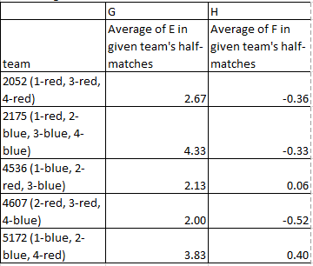
OpR calculation method 1, iterative averages
The OPR changes are also much smaller, turns out average scores was a better estimate of team performance than just saying everyone will score 0

Slide 16
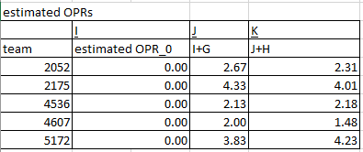
OpR calculation method 1, iterative averages
Here we are then, our estimated OPRs after two iterations
Let’s plug them into the estimated scores and see how we’re doing

Slide 17
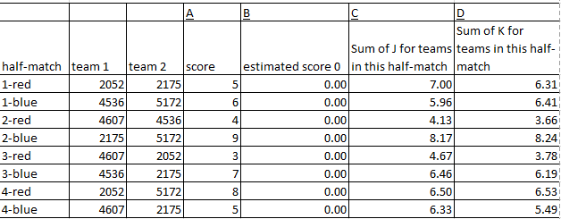
OpR calculation method 1, iterative averages
Not perfect by any means, but the error is now +-1.5 points for all scores

Slide 18
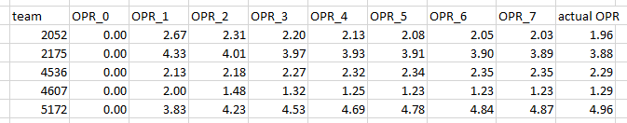
OPR Calculation Method 1, Convergence
If we continue this process forever, this iterative method will converge to normal OPR.

Slide 19
Pause for questions

Slide 20

OPR calculation method 2, linear algebra approach using matrix inversion
This method is generally how people calculate OPRs in software, all of my OPRs are calculated using the formula below.
The idea is to use tools of linear algebra to simplify the processes from methods 1 and 2.
For those of you who have learned linear algebra, the equation is below, where X is a schedule matrix, y is a score matrix, and beta is the calculated contribution. Read the wikipedia article on least squares regression to learn how it’s derived, or ask me after.

Slide 21
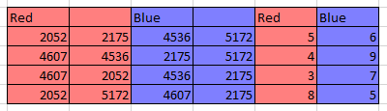
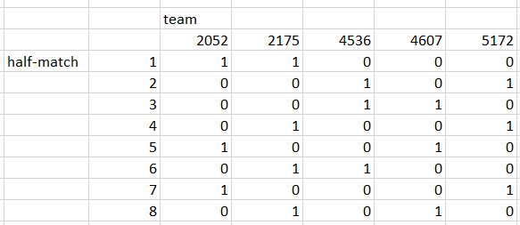
OPR Calculation method 2, Step 1
Here is the schedule, as well as the schedule matrix

Slide 22
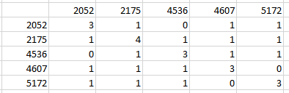

OPR Calculation method 2, Step 2
Find a matrix which shows how many matches each team plays with every other team

Slide 23
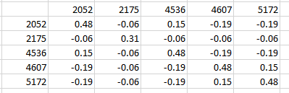

OPR Calculation method 2, Step 3
Invert that matrix, which gives a numerical value of how “important” each team is for every other team’s OPR

Slide 24
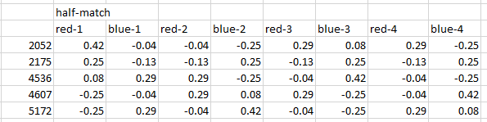

OPR Calculation method 2, Step 4
Multiply that matrix with a transposed schedule matrix to determine how “important” each half-match is for each team

Slide 25
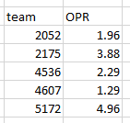

OPR Calculation method 2, Step 5
Multiply with whatever score matrix you are interested in, and then you’re done! You’ve found that calculated contribution

Slide 26
OPR calculation method 3, Choleskey decomposition
Go take a linear algebra course to understand this one. Here’s the wiki article.
This method is best for calculating OPRs using more than a single event worth of data, or if you are using a program with limited processing power. Using my computer and excel, here are rough timetables for OPR calculations:
I actually use matrix inversion for all of my work because I rarely calculate global OPRs and I’m lazy.
Method | Matrix Inversion | Choleskey decomposition
Single event | 1 second | <1 second
All events in 2018 | ~4 hours | 2 seconds

Slide 27
CCWM, DPR, and component OPRs
Once you know how to calculate normal OPR, calculating all of these other metrics are trivial, just swap in the “score” with whatever you want.
For CCWM, replace red’s score with (red score-blue score) and likewise for blue
For DPR, replace red’s score with blue’s score and likewise for blue (Note that DPR sucks)
For Component OPRs, replace red’s score with whatever component of red’s score you are interested in and likewise for blue
Due to our assumption of linearity, one interesting property is that any metrics that are linearly related will have corresponding linear OPR relationships. For example, since (for red) the winning margin is defined as (red score-blue score), we have that CCWM = OPR – DPR. Likewise, if you sum auto+teleop+penalty calculated contributions, you will get OPR.

Slide 28
Pause for questions

Slide 29
What is Elo
The Elo rating system is a method for calculating the relative skill levels of players in zero-sum games such as chess. It is named after its creator Arpad Elo, a Hungarian-American physics professor. -Wikipedia
If you have ever played any online games that have match-making algorithms, you have probably used some variant of the Elo rating system.
The basic idea is to give each team (and by extension each alliance) a rating, and then to predict the match outcome when looking at both alliance ratings. After the match, we compare our predicted results to the actual results. Teams/alliances which overperformed our expectation will see their ratings increase, while teams that underperformed will see their ratings decrease.
There are lots of different ways you can set up an Elo model, so from here on I’m going to be talking about how I set up mine.

Slide 30
Assumptions for My Elo
Maximize predictive power
Use as few parameters as possible, and only use parameters that improve predictive power in all recent (i.e. 2002+) FRC seasons (possibly excepting 2015)
Only use data that has been available since 2002, which is basically just alliance composition and final scores.
Minimal tuning required at the start of a new season
Team Elos can be taken as a raw sum together to get the alliance Elo
Average Elo = 1500, and an Elo difference of 400 indicates the stronger alliance is a 91% favorite. This lines up with most Elo systems, although these specific choices are arbitrary

Slide 31
Some key differences between Elo and OPR
OPR is a mathematical construct that happens to be well-suited for FRC purposes. As such, it has strong mathematical foundations and useful mathematical properties.
Elo is an ad hoc mess designed just to make the best predictions possible. There are mathematical underpinnings, but the key properties of an Elo model are experimentally derived parameters that give the model the properties we desire.
OPR is calculated all at once on a set of matches (usually just matches at a single event). That is, no outside information is required. Elo in contrast, always requires a “seed” Elo value, and cannot be calculated at an event without first using some“seed” rating going into the event.
Elo is zero-sum, which means that in season, the average Elo rating will always be the same. OPRs are only tied to scores, so if the average score goes up, the average Elo of teams at that event will also go up.

Slide 32
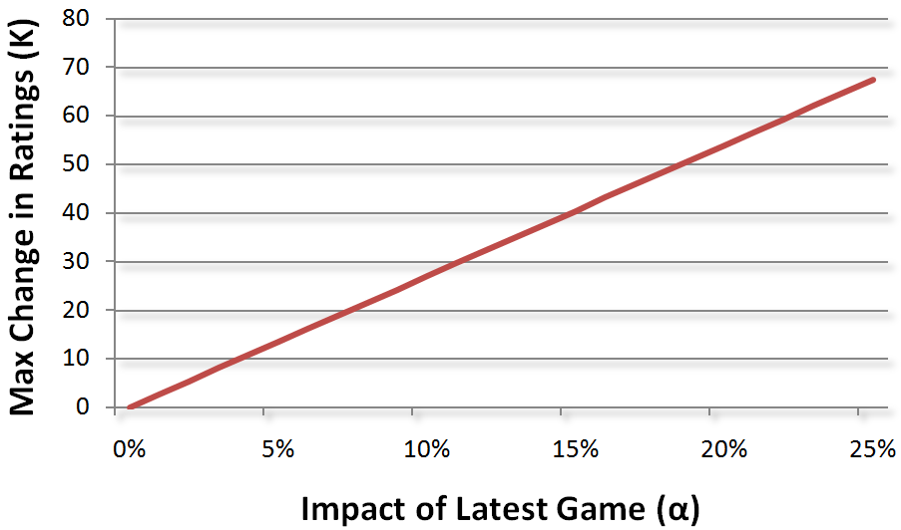
Key parameters (in season)
My model has 7 parameters which were experimentally derived, the following 2 are the only 2 used during the season:
kQuals = 12: A k value indicates how much a team’s rating should change based on the results of a single match. As you can see in the below chart, this means that roughly 5% of a team’s rating comes from their performance in the previous match
kPlayoffs = 3: The playoff k-Value is one quarter of the quals value. The reason for this is likely because, once teams enter static alliances in playoffs, it is difficult for the model to tell which team is actually responsible for successes/failures on the field, since all 3 alliance members will always have the same winning margins.
Elo to score ratio = 0.004: This parameter indicates what winning margin the Elo model should predict based on a difference in team Elos going into a match. This value means that, in a match where the red alliance is 250 Elo points above Blue, we would expect the final score to be 1 score standard deviation in red’s favor.

Slide 33
Key Parameters (between seasons)
Rookie/New Veteran Elo = 1450: Remember, average Elo is 1500, so 1450 corresponds to roughly a 30th percentile team
Previous season Elo weight = 70%: Each team’s Elo at the start of a 2019 will be 70% of their 2018 max Elo plus 30% of their 2017 max Elo (max Elos ignore each team’s first 8 matches)
End of season mean-reversion = 20%: This means that a team’s Elo at the start of a new season is dropped 20% toward the mean-reversion Elo. Essentially, teams go into a new season on average at about 80% of their strength the previous season.
Mean-reversion Elo = 1450: Because we are using max Elos, the end of season mean reversion must be below 1500 to keep the league average at around 1500.

Slide 34
Elo example
Using 2007 and score stdev = 32.9, this is a quals match
Red alliance has teams with Elos = 1450, 1500, and 1600. Blue alliance has teams with Elos =1500, 1650, and 1700.
Elo difference = 300 in favor of blue.
Predicted blue winning margin = 300*0.004*32.9= 39.5
Suppose the actual blue winning margin ends up being 52.6.
Each team on the blue alliance will have their Elo change by (52.6-39.5)/(32.9)*12 = 5. Since Elo is zero-sum in season, we also know that each red team’s Elo will change by -5.

Slide 35
Elo over multiple seasons
2052’s historical Elo

Slide 36
Elo over a single season
2052 in their rookie year
Note that 2007 score stdev = 32.9
Team | Year | Event | Match type | Set | Match | Elo | Predicted winning margin | Win probability | Win result | Winning margin
2052 | 2007 | Wisconsin Regional | qm | 1 | 8 | 1450 | -12.4 | 36.8% | 0 | -14
2052 | 2007 | Wisconsin Regional | qm | 1 | 12 | 1449 | 2.5 | 52.7% | 1 | 3
2052 | 2007 | Wisconsin Regional | qm | 1 | 22 | 1450 | 5.2 | 55.6% | 0 | -2
2052 | 2007 | Wisconsin Regional | qm | 1 | 28 | 1447 | -9.9 | 39.3% | 1 | 22
2052 | 2007 | Wisconsin Regional | qm | 1 | 39 | 1459 | -6.0 | 43.4% | 0 | -30
2052 | 2007 | Wisconsin Regional | qm | 1 | 45 | 1450 | 8.2 | 58.8% | 1 | 6
2052 | 2007 | Wisconsin Regional | qm | 1 | 58 | 1449 | -9.7 | 39.5% | 1 | 58
2052 | 2007 | Wisconsin Regional | qm | 1 | 65 | 1474 | 20.3 | 70.8% | 1 | 14
2052 | 2007 | Wisconsin Regional | qf | 4 | 1 | 1471 | 2.5 | 52.8% | 0.5 | 0
2052 | 2007 | Wisconsin Regional | qf | 4 | 2 | 1471 | 2.4 | 52.6% | 0 | -48
2052 | 2007 | Wisconsin Regional | qf | 4 | 3 | 1467 | -1.3 | 48.6% | 0 | -8
2052 | 2008 | Minnesota Regional | qm | 1 | 1 | 1462 | -8.3 | 38.0% | 1 | 12
2052 | 2008 | Minnesota Regional | qm | 1 | 10 | 1472 | -18.9 | 24.7% | 0 | -30

Slide 37
Pause for questions

Slide 38
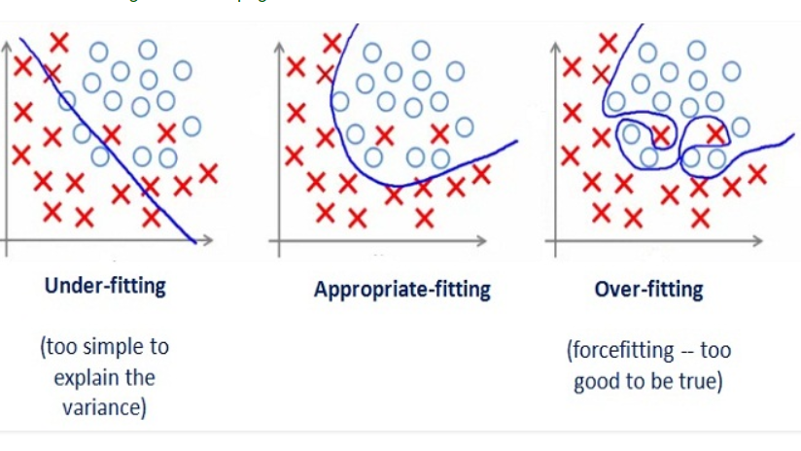
Overfitting vs Underfitting

Slide 39
Predicted Contributions (ixOPR)
When you don’t see OPRs displayed on TBA early at an event, that is because not enough matches have been played for there to be a singular solution for OPR.
When you see crazy high or low OPR values displayed early at an event, that is because the OPR model is drastically overfit, so it doesn’t represent anything meaningful
You need to have at least as many half-matches as teams for there to be a solution to OPR, and my personal rule is that OPR doesn’t become meaningful until there have been at least 1.5X as many half-matches as teams.
This really stinks though, ideally, we could adapt OPR somehow to give us reasonable values early at events. Enter ixOPR or “predicted contributions”

Slide 40
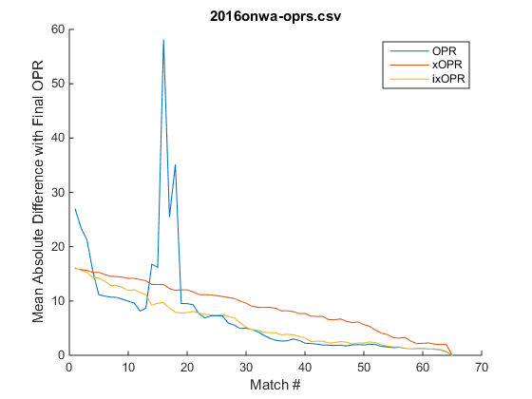
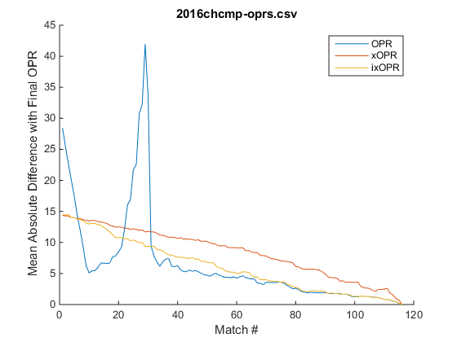
Predicted Contributions (ixOPR)
ixOPR was developed by Eugene Fang in 2016 to approach the aforementioned problems. His implementation involved estimating the scores of matches that hadn’t been played yet, and then running OPR calculations on those matches combined with matches that had actually been played.

Slide 41
Predicted Contributions (ixOPRs)
For best results, ixOPRs need to be “seeded” properly with some starting OPR for each team.
One option is to use 0 as a seed, which is safe, but we can usually do better.
For fastest convergence, I generally use:
each team’s max in-season OPR if the team has competed in the current season
90% of a team’s max previous-season OPR, and then adjusted for the current season by normalizing the average and stdev of OPRs between seasons
An OPR which is 0.4 standard deviations below the average for rookies that have not yet competed

Slide 42
Future Developments (theoretical and practical) that I’m planning to dive into eventually
A more advanced Elo that requires much more tuning at the start of each season, and to incorporate detailed score breakdowns
Elo-like iterative metrics for bonus RPs
Diving into the Zebra DART data
More and better awards predictions
Alliance selection predictions

Slide 43
Rant about the name “OPR”
The name OPR is really awful, so I prefer to use “calculated contribution”.
Offensive – This word is obsolete, it made reasonable sense when the only
Power – This word is meaningless, just makes it sound cooler.
Ranking – This word is just wrong, at least try to use “Rating” instead

Slide 44
That’s all folks
Feel free to reach out to me for any questions or comments on Chief Delphi or by email: calebsyk@gmail.com
All of my work can be found on my GitHub: https://github.com/inkling16/
Scouting Database
Event Simulator
Historical Elos

